Slide 1




Offers
Offer
Offer
7: Requester confirms Dropoff
4: Offerer confirms Pickup
1: New
2: Matched
3: Runner selected
6: Pickup confirmed x2
9: All Complete
Request
Requests
Volunteer
5: Runner confirms Pickup
8: Runner confirms Dropoff
Problem!

Slide 2
TEST CASES
Pete offers to Jane, Jane is Runner
Jane confirms pickup before Pete
Pete confirms pickup before Jane
Pete offers to Jane, W.Gaca is Runner
W.Gaca confirms pickup before Pete
Pete confirms pickup before W.Gaca
Jane confirms delivery before Pete
Pete confirms delivery before Jane
Pete offers to Jane, Pete is Runner
Jane confirms delivery before Pete
Pete confirms delivery before Jane

Slide 3
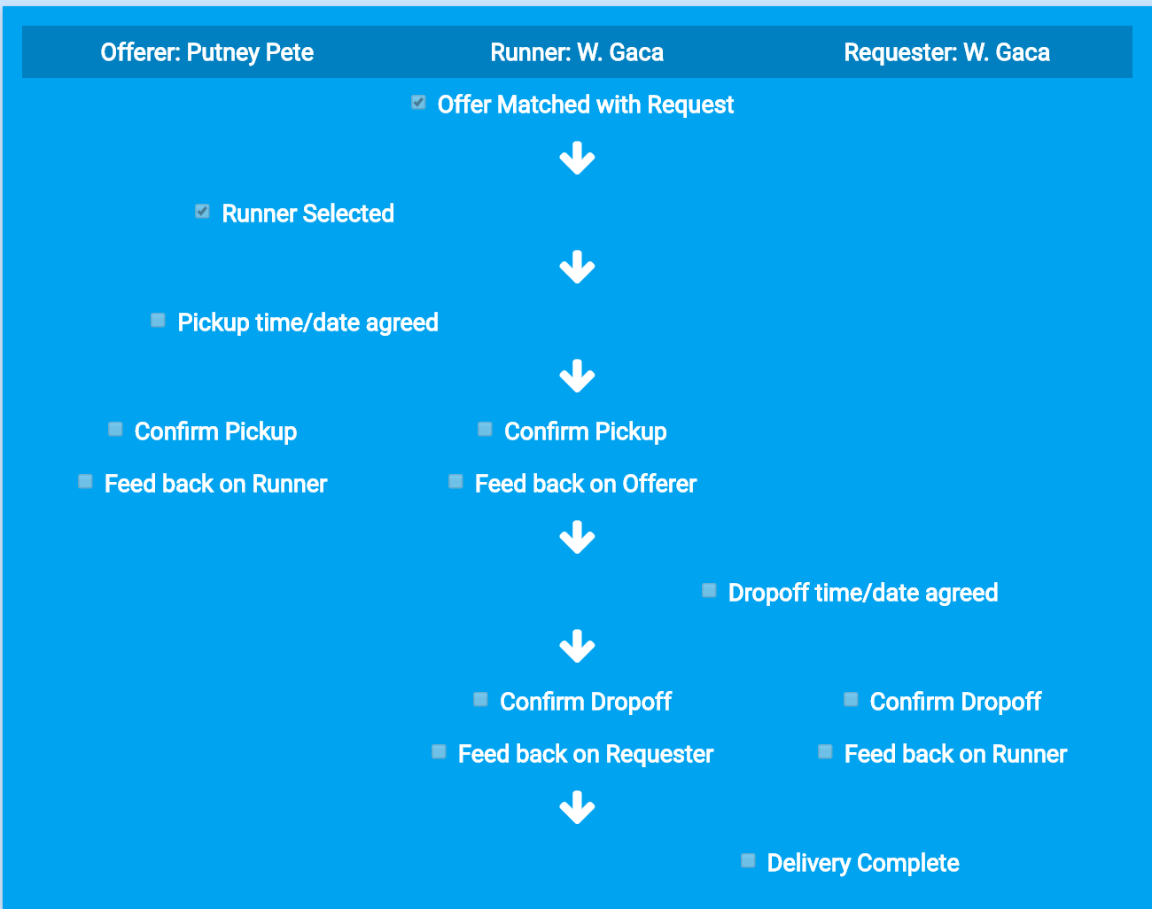
1
2
3
4
5
6
7
8
9
10
11

Slide 4
1
2
4
11

Slide 5
1
3
5
6
7
9
11

Slide 6
6
8
10
11

Slide 7
6
7
9
11

Slide 8
1
3
5
11

